Slide 1
great outdoors Group-b
BY
Prafull Sharma
C Akhil Chowdary
Sravani
Arshpreet
Ayush Agarwal
Abhishek Pratap Singh

Slide 2
EPIC and user stories
This section deals with two things namely, order initializing and order cancelling
Order initializing:
It involves:
Selecting the required quantity of products from the available ones
Removal of selected products (if the retailer has a change of mind in case)
Confirming the products to buy and upon confirmation we generate an order Id and
Maintain the list of products ordered in the current order and also we add this order to the list of orders ordered by the retailer previously
Order cancelling:
It involves:
Validates if the order exists
Checking if the order is applicable for cancellation
Validation of product to be cancelled and the quantity of product to be cancelled

Slide 3
USE CASE DIAGRAMS

Slide 4
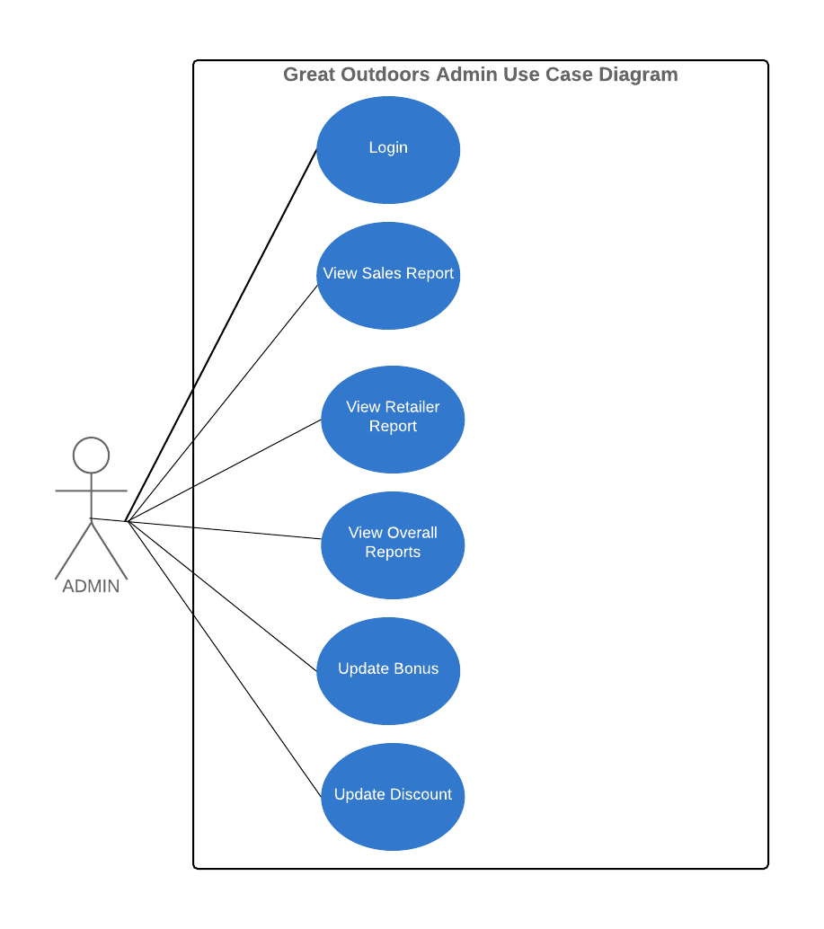

Slide 5
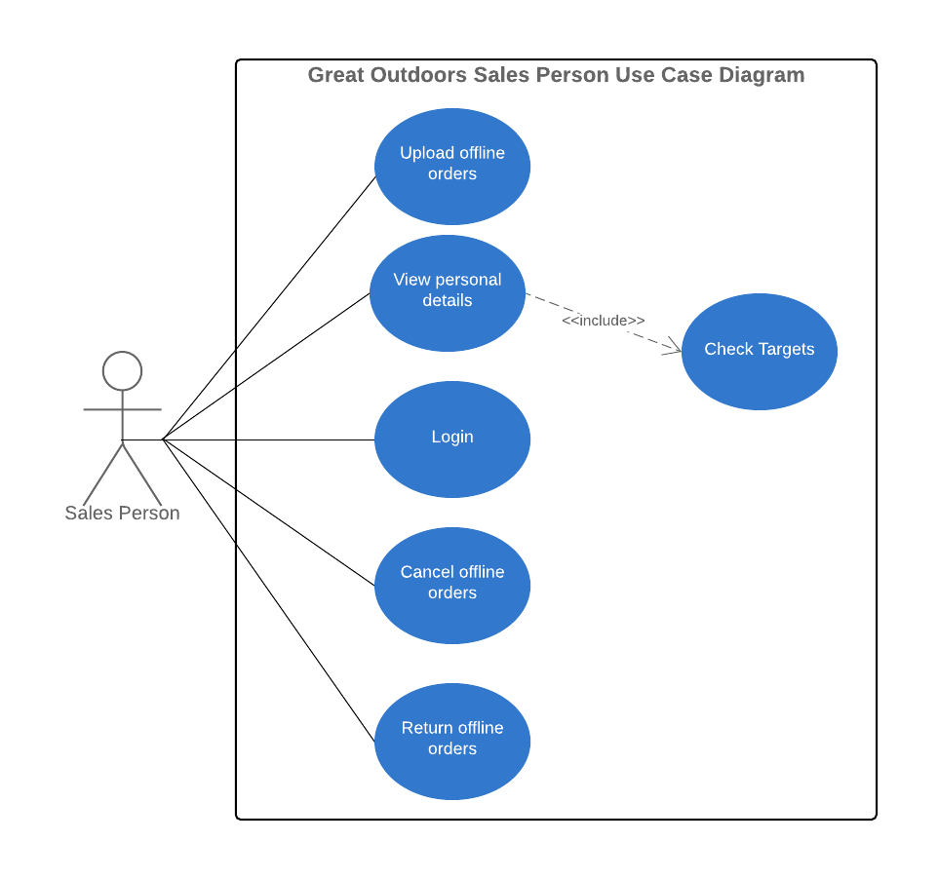

Slide 6
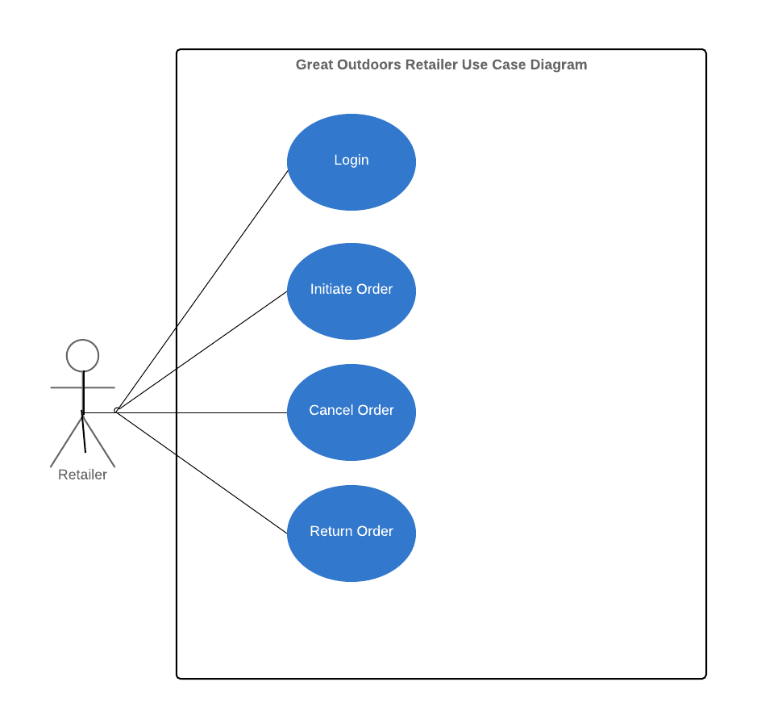

Slide 7
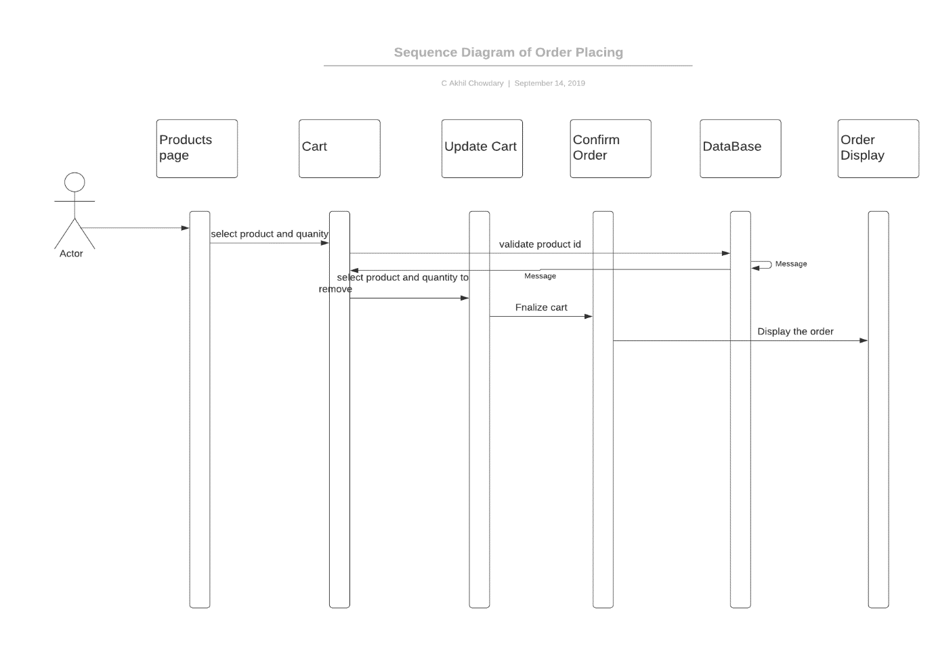
Sequence diagram: order initialization

Slide 8
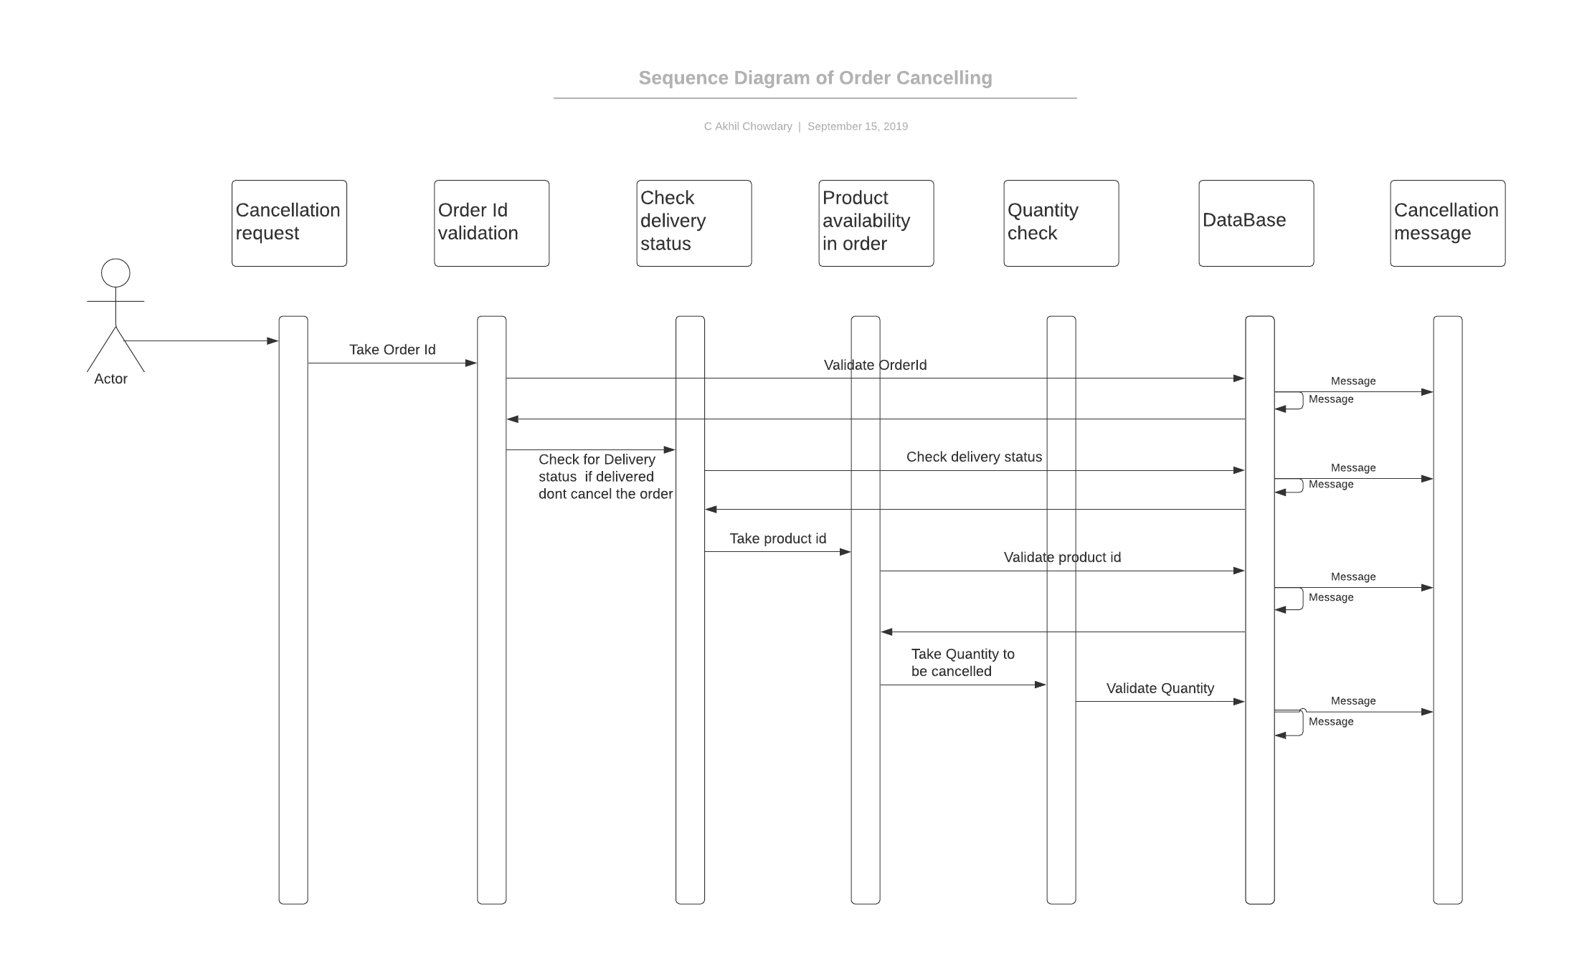
Sequence diagram: order cancellation

Slide 9
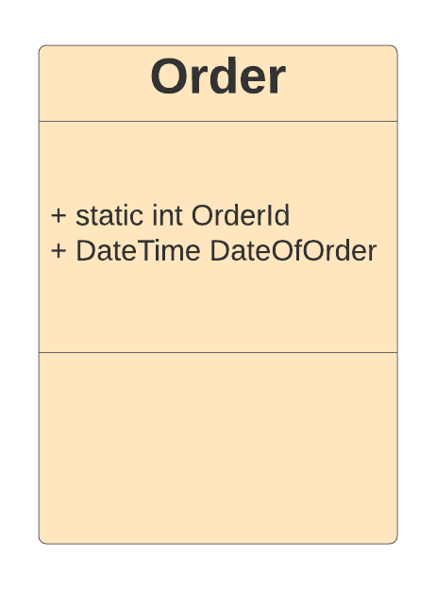
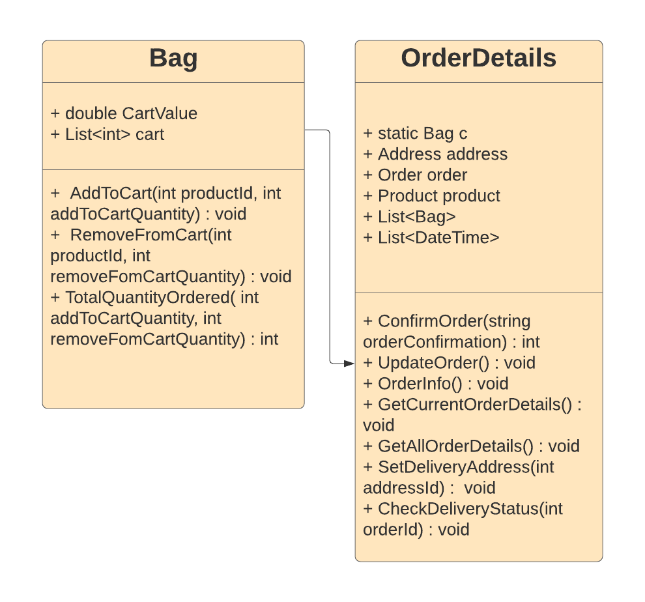
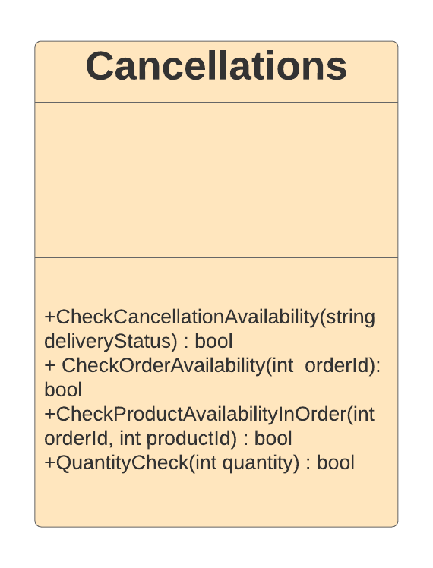
class diagram
GreatOutdoors.Entities:
GreatOutdoors.DataAccessLayer
GreatOutdoors.BusinessAccessLayer

